Slide 1
SPEECH EMOTION RECOGNITION
TEAM MEMBERS:
VAIBHAV KUMAR KARAN DEEP DAS KANHAIYA KUMAR SAHU CHINMAY UDAYBHANU THAKUR
Notes:
© Copyright PresentationGO.com – Free Templates & Infographics for PowerPoint and Google Slides

Slide 2
PROBLEM STATEMENT
OVERALL GOAL:
Speech Emotion Recognition (SER): Predict emotional states (e.g., happy, sad, angry) from audio recordings.
WHY SER MATTERS:
Critical for human–machine interaction (e.g., empathetic virtual assistants, call centres, health monitoring). Allows systems to adapt to user moods in real-time.
MOTIVATION GAPS:
Many SER solutions rely on single-dataset or small data, limiting generalization. Standard MFCC-based CNN/RNN approaches may not capture long-range temporal dependencies. Ensemble methods in SER are less explored—combining multiple architectures could boost robustness.
Notes:
© Copyright PresentationGO.com – Free Templates & Infographics for PowerPoint and Google Slides

Slide 3
Related Work on the Field
Reference Paper :
J. Ye, X. -C. Wen, Y. Wei, Y. Xu, K. Liu and H. Shan, "Temporal Modeling Matters: A Novel Temporal Emotional Modeling Approach for Speech Emotion Recognition," ICASSP 2023 - 2023 IEEE International Conference on Acoustics, Speech and Signal Processing (ICASSP), Rhodes Island, Greece, 2023, pp. 1-5, doi: 10.1109/ICASSP49357.2023.10096370.
Key Points of TIM-Net:
Temporal-Aware Blocks (TABs): Dilated causal convolutions for Long-range context capture and Temporal attention mechanism to focus on important frames.
Bi-Directional Module: Integrates information from past and future frames.
Multi-Scale Fusion: Learns features at different dilation rates; dynamically fuses them.
Notes:
© Copyright PresentationGO.com – Free Templates & Infographics for PowerPoint and Google Slides

Slide 4
Proposed Novelty
Multi-Dataset Training :
We combine SER well known datasets RAVDESS, TESS, CREMA-D, SAVEE to get larger combined data helping in stronger generalization.
Extended Feature Extraction :
Beyond MFCC also using ZCR, Chroma STFT, RMS, to get additional pitch/energy nuances to better differentiate emotions .
Self-Supervised Pretraining and Model Ensembling:
Wav2Vec2 to learn general speech features from unlabeled data and Model Ensemble with BLSTM as different model ensemble often yields higher accuracy.
Notes:
© Copyright PresentationGO.com – Free Templates & Infographics for PowerPoint and Google Slides

Slide 5
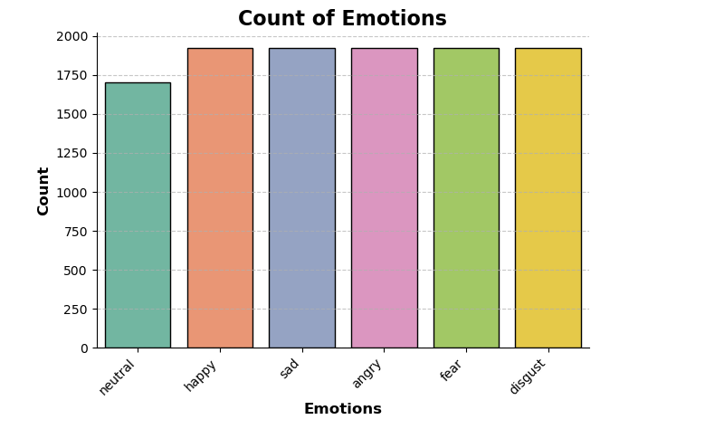
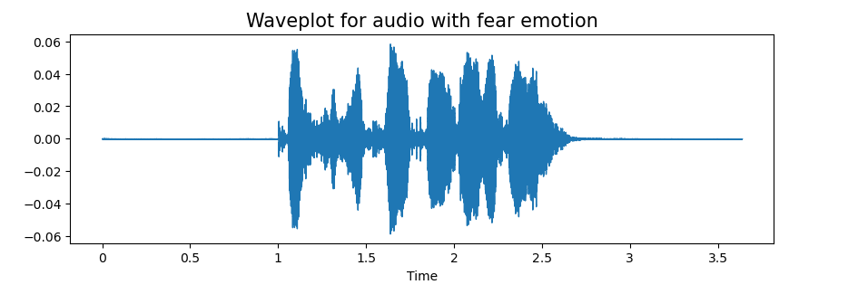
Progress Up till Now
Successfully combined dataset of RAVDESS, TESS, CREMA-D, SAVEE.
Visualization of Audio Emotion’s wave plot and spectrogram.
Implemented MFCC, ZCR, Chroma STFT, RMS, to get additional pitch/energy and various features extracted from our dataset.
Notes:
© Copyright PresentationGO.com – Free Templates & Infographics for PowerPoint and Google Slides

